Slide 1

Netflix Movie Recommendation System:
Delivering the perfect movie to every user, every time.

Slide 2
🎯 Problem & Solution (for Presentation)
Problem Statement
People spend too long deciding what to watch on Netflix. With thousands of titles and sparse user feedback in our dataset (no ratings history), users need a fast way to discover similar movies to a title they already like.
Constraints
No reliable user–item interaction data (ratings/watch history not available).
High‑dimensional, noisy text features (titles, summaries, actors, tags).
Multilabel categorical features (genres, languages).
Objective
Build a content‑based recommendation system that, given a movie title, returns a ranked list of similar movies with reasonable quality and latency for an interactive app.

Slide 3
Proposed Solution
Feature Engineering
Text: TF‑IDF over Summary + Tags + Director + Actors (unigrams & bigrams).
Categories: Multi‑label one‑hot for Genres and Languages.
Numerics: Composite_Score = 0.7*IMDb + 0.3*HiddenGem, log‑scaled IMDb Votes, standardization.
Dimensionality Reduction
PCA preserving 95% variance → speeds up clustering & similarity search while denoising.
Clustering
K‑Means (k=7) on PCA space to partition titles into coherent groups.
Recommendation Logic
Given a seed title → find its cluster → rank other titles in that cluster by cosine similarity to the seed’s feature vector → return Top‑N.
Why This Works (Intuition)
Movies within the same cluster share similar topics/attributes (genre, cast, language).
Ranking by cosine similarity inside the cluster focuses on the most semantically close items → higher precision at the top.

Slide 4
🧑‍💻 Core Technologies Powering the System
Python:
The foundational language for all backend logic and data processing, leveraging its rich ecosystem for machine learning.
Pandas:
Essential for efficient data manipulation, cleaning, and preparation of the movie dataset.
Scikit-learn:
The robust library used for implementing K-Means Clustering and other machine learning algorithms.
Streamlit:
For quick and easy deployment of the interactive web application, allowing users to interact with the recommendation system.
Pickle:
Used for serializing and deserializing machine learning models and data preprocessors for persistence and faster loading.

Slide 5






🚀 Key Features & User Experience
Dynamic Recommendations
Intuitive Controls
Receive movie suggestions instantly based on a user-selected title.
Effortlessly adjust preferences and the number of recommendations via a user-friendly sidebar.
"Surprise Me" Function
Personalized Watchlist
Discover unexpected cinematic gems with a single click, perfect for adventurous viewers.
Organize and save favorite movies for future viewing, enhancing personal library management.
Trending Movies Display
Sleek User Interface
Stay updated with the most popular and currently trending films, ensuring relevance.
Enjoy a modern, clean design with engaging hover effects for a seamless browsing experience.

Slide 6
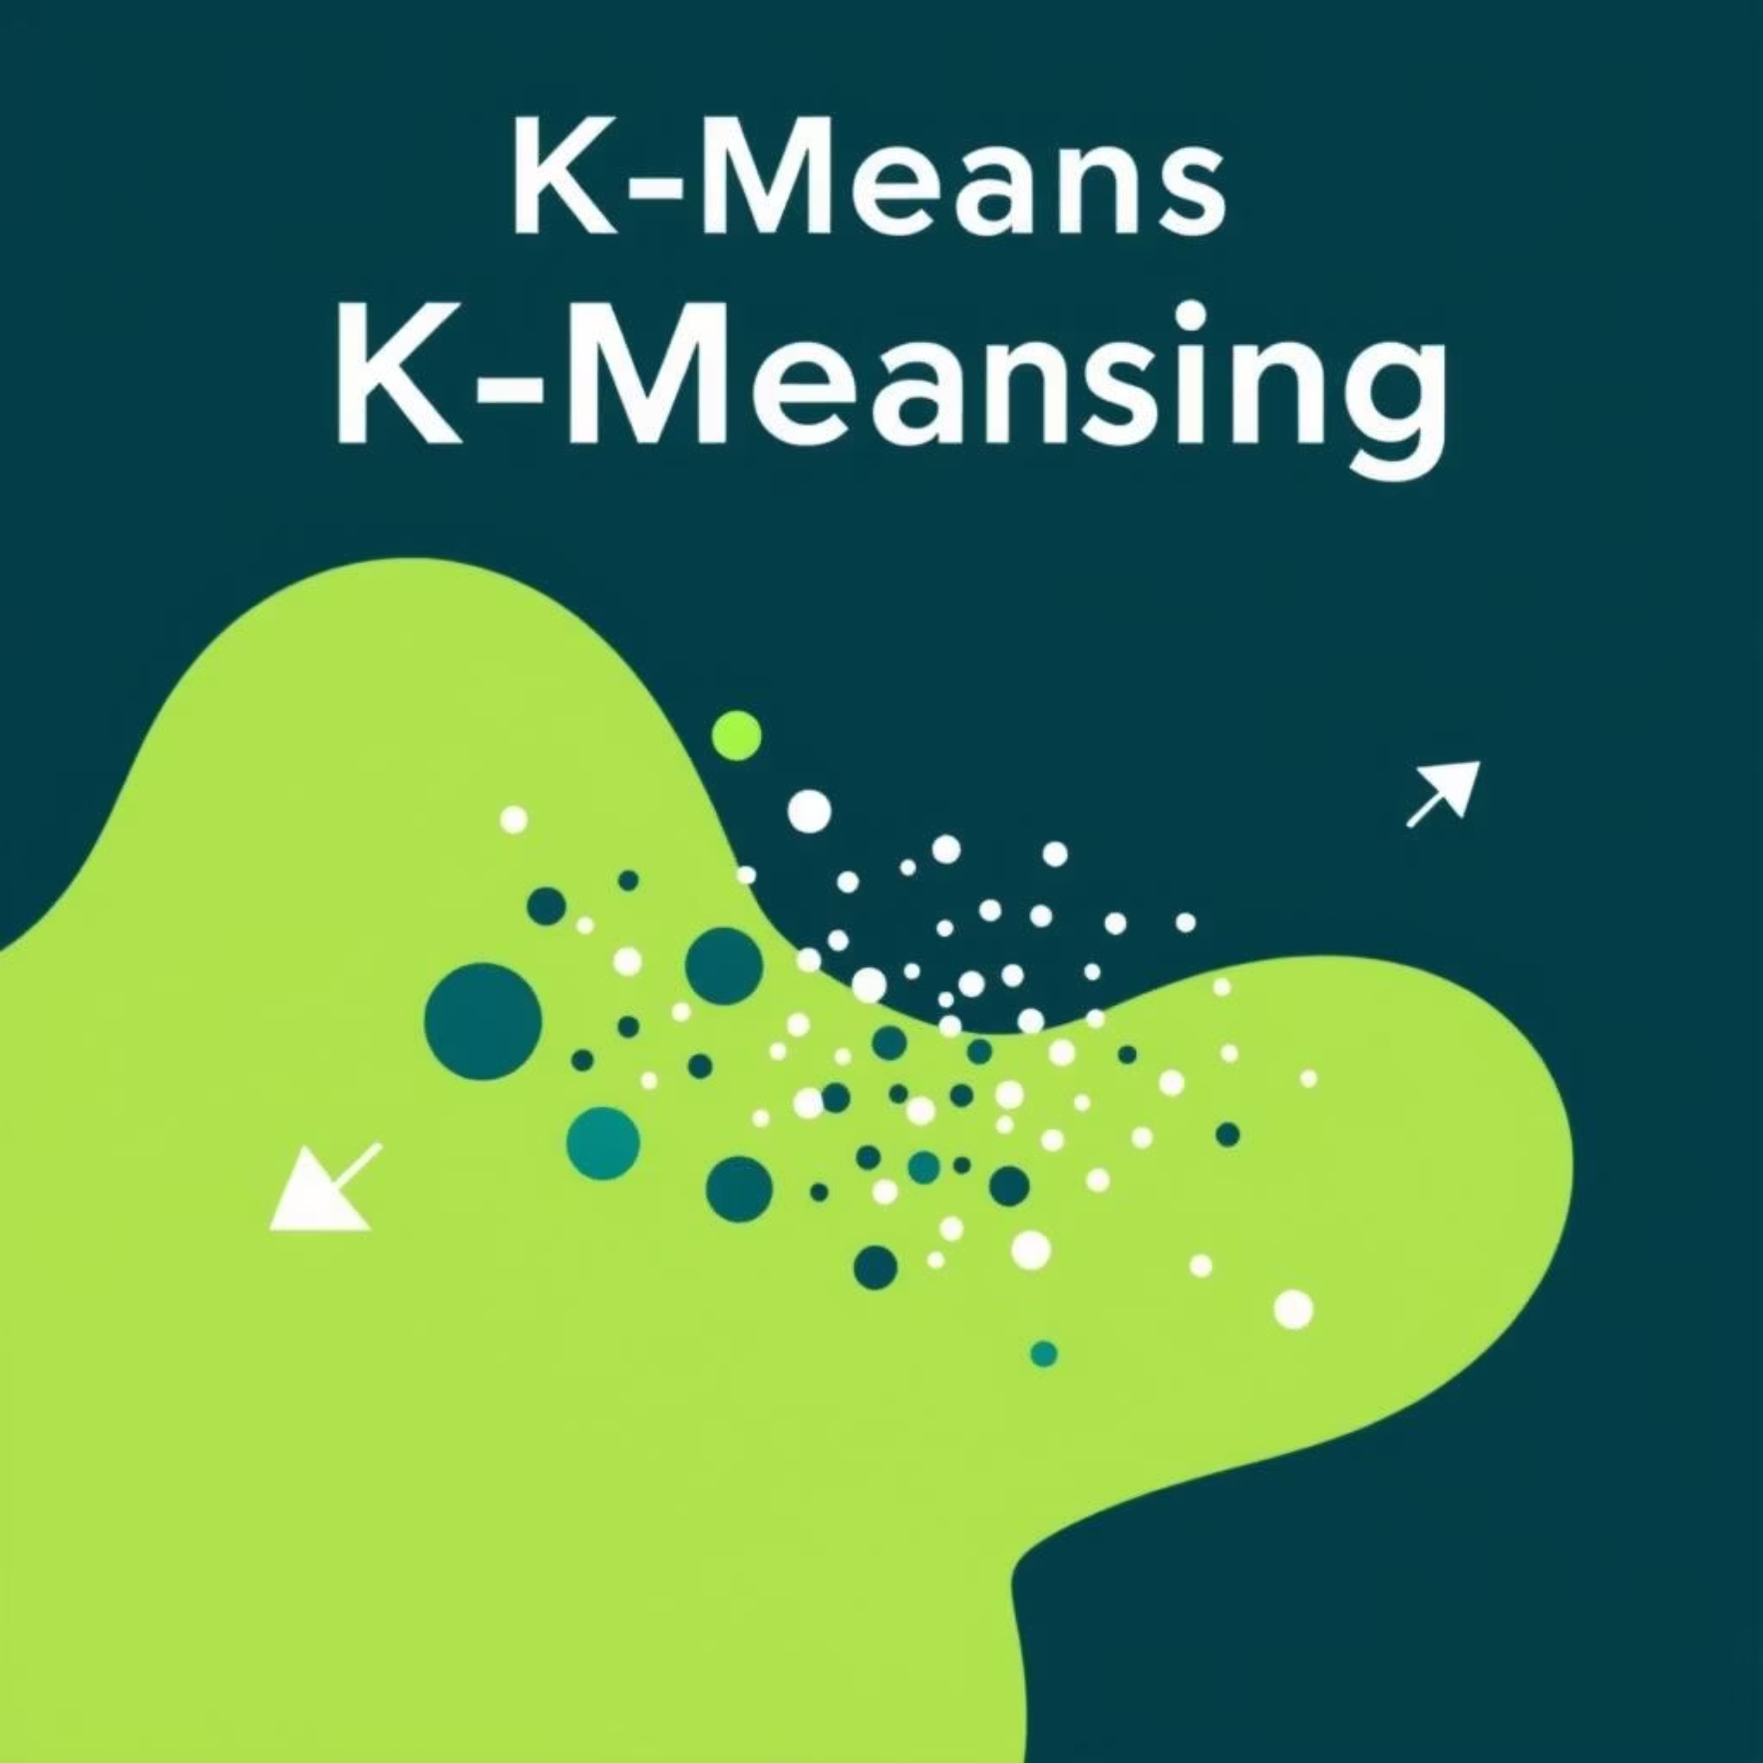

📊 Machine Learning Approach
Our recommendation engine is built upon a robust machine learning foundation, designed to accurately group similar movies and suggest relevant content.
Model Used: K-Means Clustering for efficient grouping of movie data.
Dimensionality Reduction: Principal Component Analysis (PCA) to simplify data complexity while retaining key information.
Feature Engineering:
TF-IDF Vectorization for text features (titles, descriptions).
Encoding of Genre and Language categories.
Standard Scaling to normalize numerical features.
Model Evaluation: Silhouette Score
We utilized the Silhouette Score to measure the quality of our clustering, assessing how similar an object is to its own cluster compared to other clusters.
Score: 0.08095
This score indicates a reasonable separation and density within the clusters, providing a foundation for effective recommendations.

Slide 7
🏆 Our Visionary Team
This project was brought to life by the dedication and expertise of our talented team:
Omar Ahmed
Amr Awad
Marwan Amir
Rokia Hassan
Khaled Tarek
Together, we turned a complex challenge into an innovative solution, enhancing the future of personalized entertainment.

